Slide 1
Finance for Non-Finance Managers
by Tertiary Infotech Pte Ltd

Slide 2
Outline
The different financial ratios
Profitability Analysis
Cash Flow Analysis
Projected financial and cash-flow statements
The process of financial statements analysis
Use financial analysis to determine the health of an organisation
Evaluate organisation’s historical financial performance
Investment suitability based on financial analysis
Analysis for the financial services industry
Benchmarking of financial performance against industry
Use Capital Budgeting to evaluate potential investment returns

Slide 3
Financial Statements
Collection of summary level reports
Mainly used for covered
  Financial Results
  Financial Position
  Cash Flows

Slide 4
Users of financial statements
Company Management
Competitors
Customers
Employees
Governments
Investment Analysts
Investors
Lenders
Rating Agencies
Suppliers

Slide 5
Key Financial Statements
Statement of Financial Position
Balance Sheet
Statement of Financial Results
Profit and Loss Statement
Cash Flows
Cash Flows statement

Slide 6
Balance Sheet
Statement of net-worth or financial position
Components
  Assets
  Liabilities
  Equity
Fundamental Equation
  Assets = Liabilities + Equity

Slide 7
Balance Sheet Components
Assets
  Current Assets
  Long-Term Assets
Liabilities
  Current Liabilities
  Long-Term liabilities
Total Shareholder’s Equity
  Share Capital
  Retained Earnings

Slide 8
Assets
Current Assets
  Cash and cash equivalents
  Accounts Receivable
  Inventories
  Marketable Securities
Long-Term Assets
  Plant Property and Equipment (PP&E)
  Intangible Assets

Slide 9
Current Assets – Cash and Cash Equivalents
Cash
  Legal Tender
  Bills
  Coins
  Checks
Cash equivalents
  Banker’s Acceptance
  Commercial Paper
  Any short term investment securities with maturity less than 90 days

Slide 10
Cash vs Accrual basis accounting
Cash accounting records business transactions when cash flows into business
Accrual Accounting records business transactions when they are incurred regardless of when money actually changes hands
Financial Statements use accrual accounting

Slide 11
Current Assets – Accounts Receivable
Funds owed by customers to the company
The invoice amount is recorded as an Accounts Receivable once the company delivers goods or services to the customer.

Slide 12
Current Assets - Inventory
Merchandise
Raw materials
Work-in-progress
Finished products

Slide 13
Current Assets – Marketable Securities
Common Stock
Treasury Bills
Bonds (only with maturity less than one year)

Slide 14
Long Term Assets – Plant, Property and Equipment (PP&E)
Machinery
Equipment
Vehicles
Buildings
Land
Office Equipment
Furniture
Fixtures

Slide 15
Valuation of PP&E
Cost Model
Revaluation Model

Slide 16
Depreciation of PP&E
Spreads the cost of the asset over a period of time
Match the expense of asset to income it produces
The method of depreciation chosen can impact the financial results

Slide 17
Common Depreciation Methods
Straight Line
Double Declining
Sum of Years
Units of Production

Slide 18
Depreciation – Straight Line Method
Expense amount is the same every year
Depreciation expense = (Cost – Salvage Value) / Useful Life
A machine is bought for $50,000 and has useful life of 10 years and $0 salvage value.
Annual Depreciation expense = ($50,000- $0)/10 = $5000

Slide 19
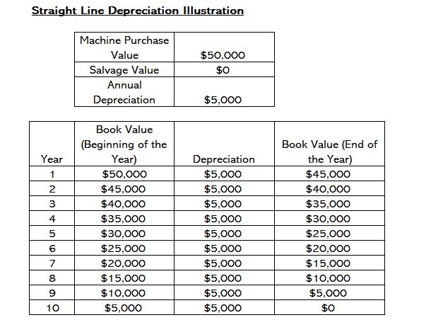

Slide 20
Depreciation – Double Declining Method
Larger expense in earlier than later years
A machine is bought for $50,000 and has useful life of 10 years and $10,000 salvage value.
Depreciation rate = (80% / useful life of asset) x 2 = 16%
Depreciation expense in first year = $50,000 x 16% = $8,000

Slide 21
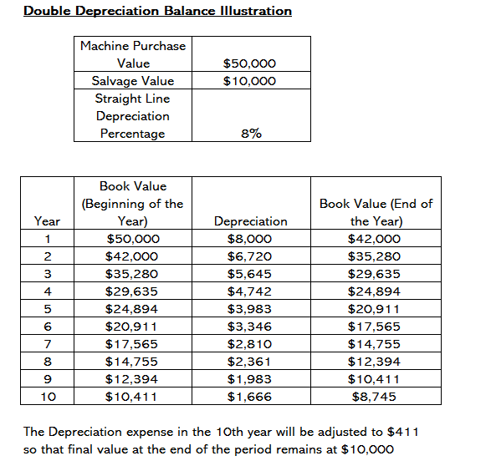

Slide 22
Depreciation – Units of Production Method
Assets are depreciated based on how long they have been used or the number of units produced
Depreciation expense = (Number of units produced / Life number of units ) x (Cost – salvage Value)
A machine costs $50,000 and an estimated production of 100 million and $0 salvage value. During the first year, it produced 3 million units.
Depreciation expense = (3 million / 100 million ) x ($50,000 -$0) = $1500

Slide 23
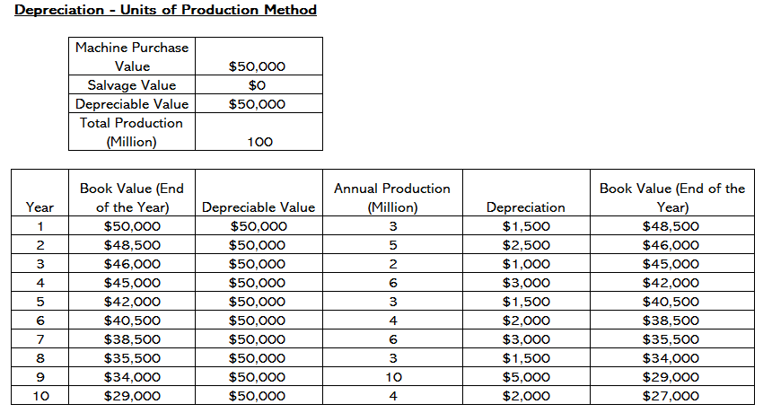

Slide 24
Depreciation – Sum of Years Method
Higher expense in early years and lower expense in latter years
Depreciation expense = (Remaining Life / Sum of the years digits) x (Cost – Salvage Value)
A machine is bought for $25,000 and has life of 8 years with salvage value of $0.
Depreciation Expense
  First Year - $5556
  Second Year - $4861

Slide 25
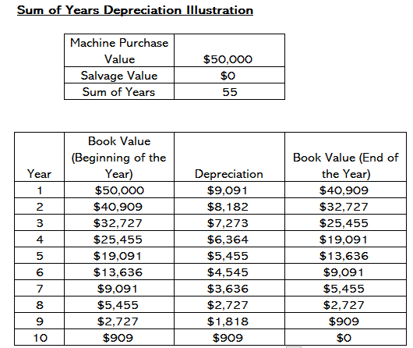

Slide 26
Long Term Assets – Intangible Assets
Assets that cannot be touched
Goodwill
Brand recognition
Copyrights
Patents
Trademarks
Trade Names
Customer Lists

Slide 27
Liabilities
Current Liabilities
  Accounts Payable
  Current Debt / Notes Payable
  Current Portion of Long Term Debt
Long-Term Liabilities
  Bonds Payable
  Long Term Debt

Slide 28
Current Liabilities – Accounts Payable
Money owed to vendors or suppliers

Slide 29
Current Liabilities – Current Debt
Formal borrowings of the company
Payable within one year

Slide 30
Current Liabilities – Current Portion of Long Term Debt
Unpaid principal from long term debt accrued within current operating cycle.

Slide 31
Long Term Liabilities – Bonds Payable
Obligation to repay principal at a future date
Repay interest on annual or semi-annual basis at regular intervals
Types of bonds
  Serial Bonds
  Sinking Fund Bonds
  Convertible Bonds
  Registered Bonds
  Secure Bonds
  Debenture Bonds

Slide 32
Long Term Liabilities – Long Term Debt
Debts owed to creditors payable beyond 12 months

Slide 33
Working Capital
Current Assets – Current Liabilities

Slide 34
Shareholder’s Equity
Share Capital
Retained Earnings

Slide 35
Shareholder’s Equity – Share capital
Money invested by owners in the business
Can be common or preferred shares
Common types of Share Capital
  Authorized Share capital
  Issued Share capital
  Subscribed Capital
  Called-up Capital
  Paid-up Capital

Slide 36
Shareholders Equity – Retained Earnings
Net Profits retained by the company
Amount after all dividends and distributions

Slide 37
Income Statement
Statement showing financial performance
Also called “Profit and Loss Statement”
Components
  Revenues
  Expenses
  Profits
Fundamental Equation
  Profits = Revenues - Expenses

Slide 38

Income Statement Components
Revenue / Sales (-)
Cost of Goods Sold (=)
Gross Profit (-)
Marketing, Advertising Expenses (-)
General and Administrative Expenses (=)
Earnings Before Interest Taxes Depreciation Amortization EBITDA (-)
Depreciation and Amortization Expenses (=)
Operating Income or EBIT (-)
Interest Expenses (-)
Other Expenses (=)
EBT or Earnings Before Tax (-)
Income Tax (=)
Net Income

Slide 39
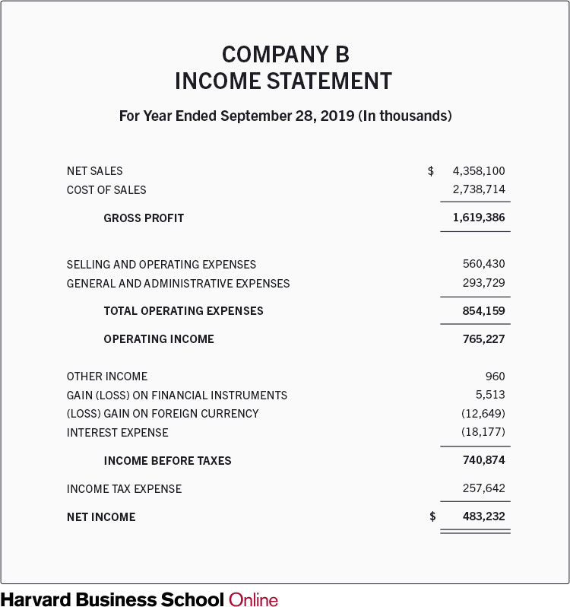
Layout of the Income Statement

Slide 40
Summary of Income Statement Items
Revenue – Cost of Goods Sold = Gross Profit
Gross Profit – Marketing expenses – Selling and General Admin Expenses = Earnings Before Interest Tax Depreciation and Amortization (EBITDA)
EBITDA – Depreciation – Amortization = Operating Income or Earnings Before Interest and Tax (EBIT)
EBIT – Interest and Other expenses = Earnings Before Tax (EBT)
EBT – Tax = Net Income

Slide 41
Cash Flow Statement
Shows the movement of cash in the business
Tracks incoming and outgoing money
Three cash activities of the company
  Operating Activities
  Investing Activities
  Financial Activities

Slide 42
Cashflow Statement – Operating Activities
Generates revenue for the company (inflow)
Money spent on production of goods (outflow)
Operating Cashflow = Operating Income + Depreciation – Taxes + Change in Working Capital

Slide 43
Cashflow Statement – Investing Activities
Gains and Losses from investments in Assets

Slide 44
Cashflow Statement – Financing Activities
Cash flow between company, shareholders and creditors

Slide 45
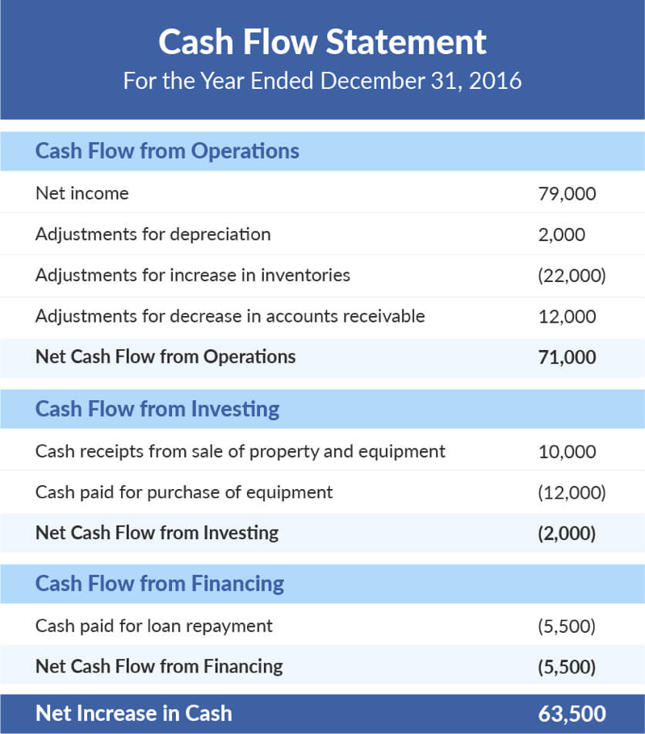
Example of a cashflow statement

Slide 46
Summary of Cash Flow items
Operating Cashflows
  Income from sale of goods
  Expenses in production of goods
Investing Cashflows
  Gains or Losses from sale or purchase of assets
Financing Cashflows
  Inflow or outflow from capital or loans

Slide 47
Statement of changes in Equity
Also called the statement of Retained Earnings
Reconciles Beginning and Ending equity during reporting period
Beginning Equity + Net Income – Dividends +/- Other changes = Ending Equity

Slide 48
Statement of changes in Equity - components
Opening Balance
Effects of changes in accounting policies
Effect of correction in prior period error
Restated Balance
Changes in Share Capital
Dividends
Income/Loss for the Period
Changes in Revaluation Reserve
Other Gains and Losses

Slide 49
Financial Ratios
Liquidity Ratios
Leverage Ratios
Efficiency Ratios
Profitability Ratios

Slide 50

Liquidity Ratios
Current Ratio
Acid Test Ratio
Cash Ratio
Operating cash flow ratio

Slide 51
Liquidity Ratios – Current Ratio
Also called Working Capital Ratio
Current Ratio = Current Assets / Current Liabilities

Slide 52
Liquidity Ratios – Acid Test Ratio
Also called Quick Ratio
Acid Test Ratio = (Current Assets – Inventories) / Current Liabilities

Slide 53
Liquidity Ratios – Cash Ratio
Cash Ratio= Cash and Cash Equivalents / Current Liabilities

Slide 54
Liquidity Ratios – Operating Cash Flow Ratio
Operating Cash Flow Ratio= Operating Cash Flow/ Current Liabilities

Slide 55
Leverage Financial Ratios
Debt Ratio
Debt to Equity Ratio
Interest Coverage Ratio
Debt Service Coverage Ratio

Slide 56
Leverage Ratio – Debt Ratio
Debt Ratio = Total liabilities / Total assets

Slide 57
Leverage Ratio – Debt to Equity Ratio
Debt to equity ratio = Total liabilities / Shareholder’s equity

Slide 58
Leverage Ratio – Interest Coverage Ratio
Interest coverage ratio = Operating income / Interest expenses

Slide 59
Leverage Ratio – Debt Service Coverage Ratio
Debt service coverage ratio = Operating income / Total debt service

Slide 60
Efficiency Ratios
Asset Turnover Ratio
Inventory Turnover Ratio
Receivables Turnover Ratio
Payables Turnover Ratio

Slide 61
Efficiency Ratio – Asset Turnover Ratio
Asset turnover ratio = Net sales / Average total assets

Slide 62
Efficiency Ratio – Inventory Turnover Ratio
Inventory turnover ratio = Cost of goods sold / Average inventory

Slide 63
Efficiency Ratio – Accounts Receivable Turnover Ratio
Receivables turnover ratio = Net sales / Average accounts receivable

Slide 64
Average Collection Period
Average Length of time for a company to collect the accounts receivable
Average Collection Period = 365 / Accounts Receivables Turnover

Slide 65
Importance of Average Collection Period
Maintain Liquidity
Plan for future costs and schedule potential expenditures

Slide 66
Average Collections Period - Illustration
A company has accounts receivable balance of $40,000 in the balance sheet. For the same year, the total net sales is $400,000.
Average collection Period = 365 x 40,000 / 400,000 = 36.5

Slide 67
Efficiency Ratio – Accounts Payable Turnover Ratio
Payables turnover ratio = Net purchases / Average accounts payable
Net purchases = Cost of Goods Sold + Ending Inventory Balance – Starting Inventory Balance

Slide 68
Average Payments Period
Average time taken for a business to pay its vendors.
Average Payments Period = 365 / Accounts Payable Turnover

Slide 69
Average Payments Period - Illustration
For a company
Beginning Accounts Payable : $100,000
Ending Accounts Payable : $ 80,000
Total Purchases on credit : $1,800,000
Average Accounts Payable : ($100,000 +$80,000) / 2 = $90,000
Accounts Payable Turnover : $1,800,000 / $90,000 =2
Accounts Payable Turnover = 365/2 = 182.50

Slide 70
Profitability Ratios
Reflect ability of business to generate earnings
Show efficiency of generating profits
Higher ratios are more favourable

Slide 71

Profitability Ratios
Gross Margin
Operating Margin
Net Profit Margin
Return on Assets
Return on Equity

Slide 72
Profit Ratio – Gross Margin
Gross margin ratio = Gross profit / Net sales

Slide 73
Profit Ratio – Operating Margin
Operating margin ratio = Operating income / Net sales

Slide 74
Profit Ratio – Net Profit Margin
Net Profit Margin ratio = Net Income / Net sales

Slide 75
Profit Ratio – Return on Assets
Return on assets ratio = Net income / Total assets

Slide 76
Profit Ratio – Return on Equity
Return on equity ratio = Net income / Total Equity

Slide 77
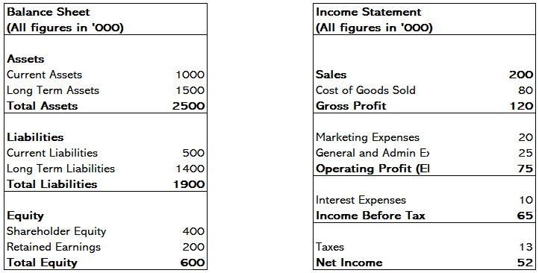
How do we measure profitability

Slide 78
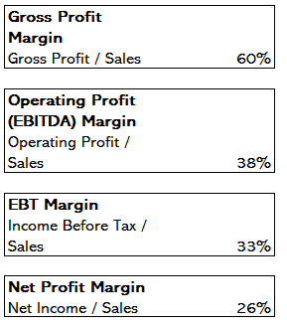
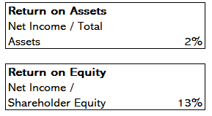

Slide 79
Summary of all ratios
Liquidity Ratios
  Current Ratio = Current Assets / Current Liabilities
  Acid Test Ratio = (Current Assets – Inventories) / Current Liabilities
  Cash Ratio= Cash and Cash Equivalents / Current Liabilities
  Operating Cash Flow Ratio= Operating Cash Flow/ Current Liabilities
Leverage Ratios
  Debt Ratio = Total liabilities / Total assets
  Debt to equity ratio = Total liabilities / Shareholder’s equity
  Debt service coverage ratio = Operating income / Total debt service

Slide 80
Summary of all ratios
Efficiency Ratios
  Asset turnover ratio = Net sales / Average total assets
  Inventory turnover ratio = Cost of goods sold / Average inventory
  Receivables turnover ratio = Net sales / Average accounts receivable
  Payables turnover ratio = Net purchases / Average accounts payable
Profitability Ratios
  Gross margin ratio = Gross profit / Net sales
  Operating margin ratio = Operating income / Net sales
  Net Profit Margin ratio = Net Income / Net sales
  Return on equity ratio = Net income / Total Equity
  Return on assets ratio = Net income / Total assets

Slide 81
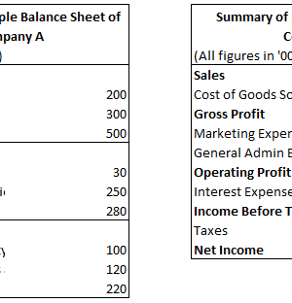
Profitability Ratios for a sample company
Gross Margin : 37.50%
Operating Margin : 26.67%
Net Profit Margin : 16.67%
Return on Equity : 9.09%
Return on Assets : 4%

Slide 82

Cash Flow Analysis
Step 1 : Identify all sources of income
1
Step 2 : Identify all business expenses
2
Step 3 : Create the Cash Flow Statement
3
Operating Activities
Investing Activities
Financing Activities
Step 4 : Analyse the cash flow statement
4
Look for any deficit patterns
Better time the expenses

Slide 83
How can business improve cash flow management
Plan for upcoming expenses
1
Increase the Income
2
Re-examine payment schedules
3
Look at average collections period
Look at average payables period

Slide 84
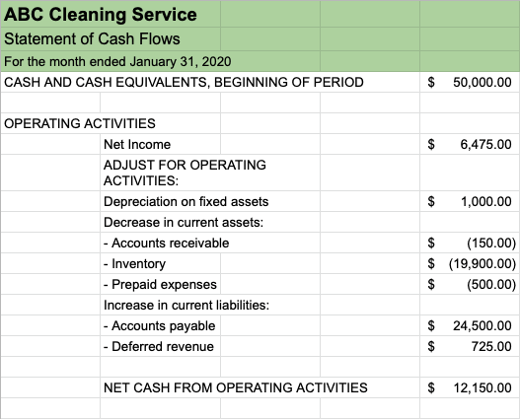
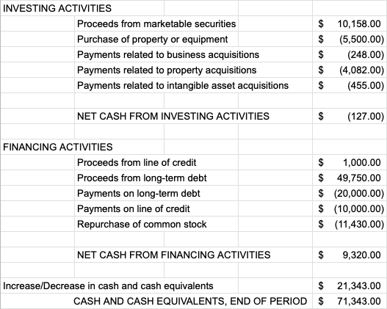
Example of a monthly cash flow statement

Slide 85

Proforma Financial Statements
Projected Financial Statements
Help in make plans and compare actual and predicted company performance
Projection done for Income Statement and Balance Sheet
Projected Cash Flow is derived from the other statements

Slide 86

Forecasting of Income Statement
Analyse Historical Data
1
Forecast Revenue
2
Predict Cost of Goods Sold
3
Determine Operating Expenses
4
Calculate Projected Net Income
5

Slide 87

Forecasting a Balance Sheet
Enter Short term and Long term assets
1
Include current and Long Term Liabilities
2
Calculate the Final Figures
3

Slide 88

Forecasting the Cash Flow Statement
Estimate the amount of cash inflows and outflows
Steps
Estimated anticipated monthly sales
Predict receipt of payments
Estimate Costs

Slide 89
Cash Flow Forecasting Methods
Direct
Cash flow = receivables - expenditures
Indirect
Start with net income and account for items affecting profit but not cash flow

Slide 90

Determine financial health of a company
Analyse Balance Sheet
Analyse Income Statement
Analyse Cash Flow Statement
Financial Ratio Analysis

Slide 91
Determine Financial Health of a company
Analyse the Balance Sheet
How much debt the company has relative to equity
How liquid the business is in the short term (less than one year)
What percentage of assets are tangible and what percentage comes from financial transactions
How long it takes to receive outstanding payments from customers and repay suppliers
How long it takes to sell inventory the business keeps on hand

Slide 92
Determine Financial Health of a company
Analyse the Income Statement
How much revenue is growing over certain accounting periods
The gross profit margin for goods sold
What percentage of revenue results in net profit after all expenses
If the business can cover its interest repayments on debt
How much the business repays to shareholders versus how much it reinvests

Slide 93
Determine Financial Health of a company
Analyse the Cash Flow Statement
The liquidity situation of the company
The company’s sources of cash
The free cash flow the company generates to further invest in assets or operations
Whether overall cash has increased or decreased

Slide 94
Determine Financial Health of a company
Financial Ratio Analysis
Gross profit margin: The percentage of profit the company generates after direct cost of sales expenses have been deducted from the revenue
Net profit margin: The percentage of profit the company generates after all expenses have been deducted from revenue, including interest and tax from revenue
Coverage ratio: The company’s ability to meet its financial obligations, specifically to cover its debt and related interest payments
Current ratio: The company’s ability to meet short-term obligations of less than one year
Quick ratio: The company’s ability to meet short-term obligations of less than one year using only highly liquid assets

Slide 95
Determine Financial Health of a company
Financial Ratio Analysis
Debt-to-equity ratio: The percentage of debt versus equity that the company uses to finance itself
Inventory turnover: How many times per period the entire inventory was sold
Total asset turnover: How efficiently the company generates revenue from total assets
Return on equity (ROE): The company’s ability to use equity investments to earn profit
Return on assets (ROA): The company’s ability to manage and use its assets to earn profit

Slide 96

Financial Statements Analysis
Evaluate the company’s financial situation
Follow up in administrative decisions
Assist in economic decisions

Slide 97

Financial Statements Analysis - Methods
Ratio Analysis
Horizontal Analysis (Trend Analysis)
Vertical Analysis

Slide 98
Ratio Analysis
Using the ratios of a business to evaluate its financial position

Slide 99
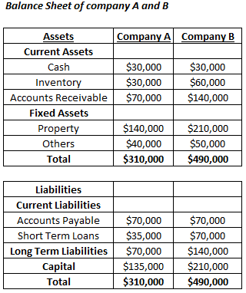
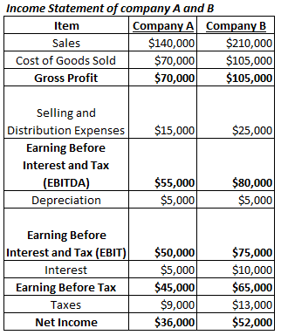
Ratio Analysis - example

Slide 100
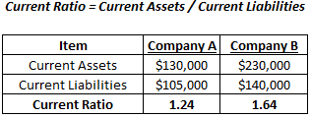
Current Ratio

Slide 101
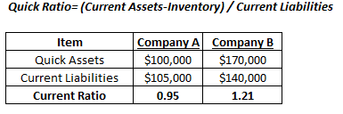
Quick Ratio

Slide 102
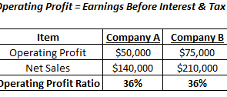
Operating Profitability

Slide 103
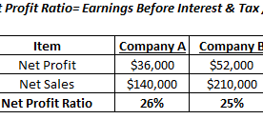
Net Profit Ratio

Slide 104
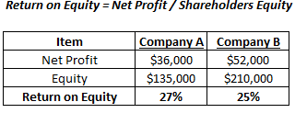
Return on Equity

Slide 105
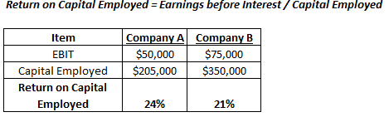
Return on Capital Employed

Slide 106
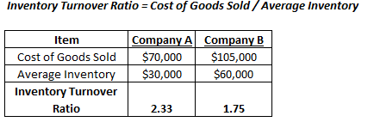
Inventory Turnover

Slide 107
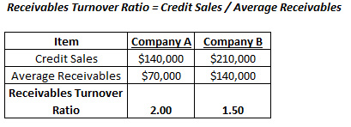
Receivable Turnover

Slide 108
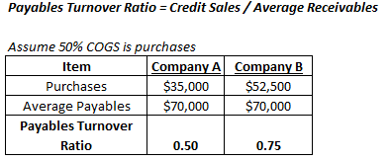
Payable Turnover

Slide 109
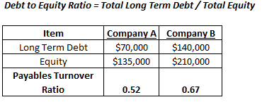
Debt to Equity Ratio

Slide 110
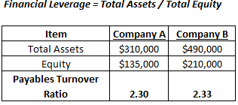
Financial Leverage

Slide 111
Horizontal Analysis
Analyse change over two or more accounting periods
Measure percentage change of same line item

Slide 112
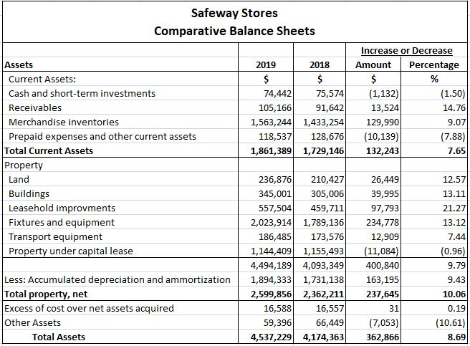
Horizontal Analysis - Example

Slide 113
Vertical Analysis
Each Item in the financial statement is shown in percentage of the base figure
All items in income statement are stated as percentage of gross sales
All items in balance sheet are stated as percentage of total assets

Slide 114
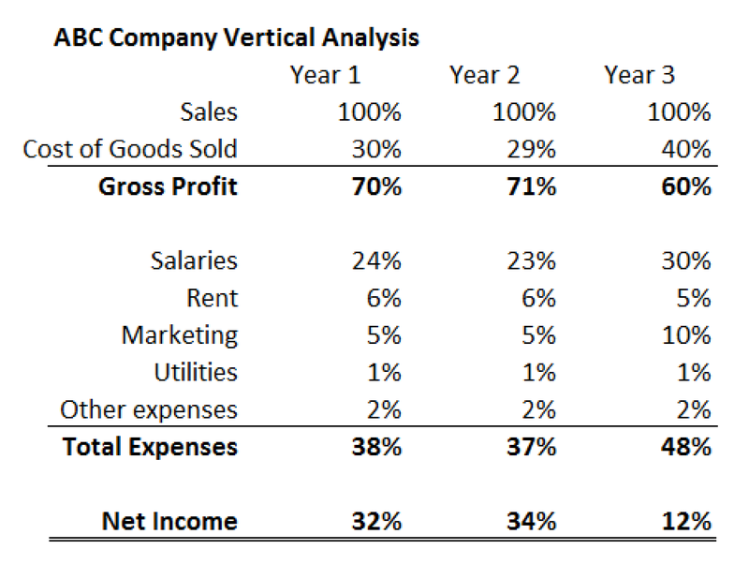
Vertical Analysis - Example

Slide 115
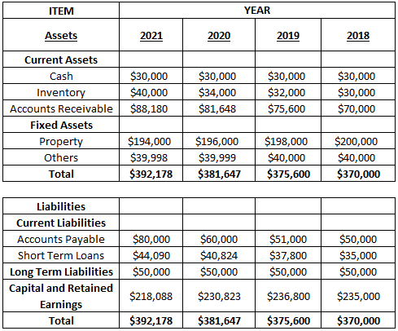
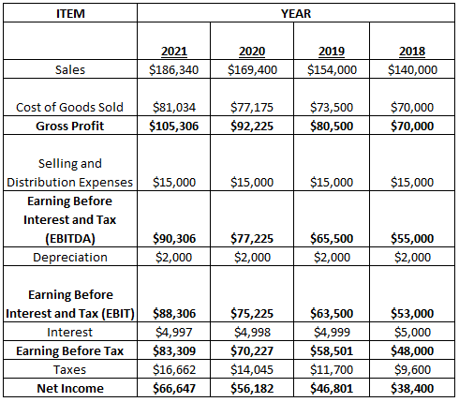
Horizontal Analysis – Case Study

Slide 116
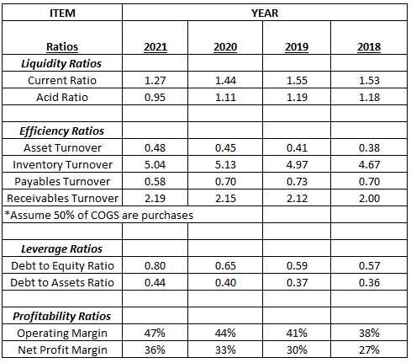
Step 1 – Generation of Ratios

Slide 117
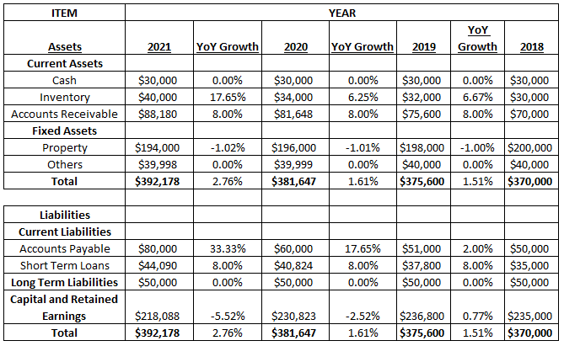
Step 2 – Trend Analysis of Balance Sheet

Slide 118
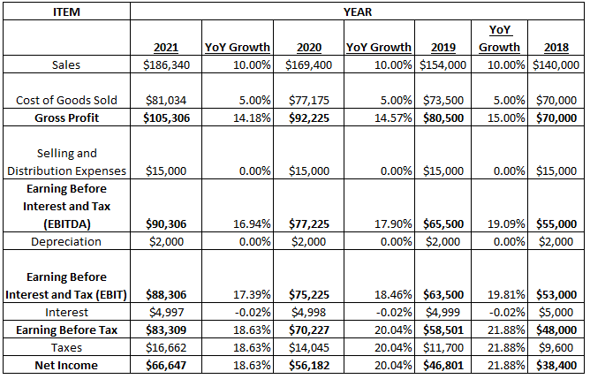
Step 3 – Trend Analysis of Income Statement

Slide 119
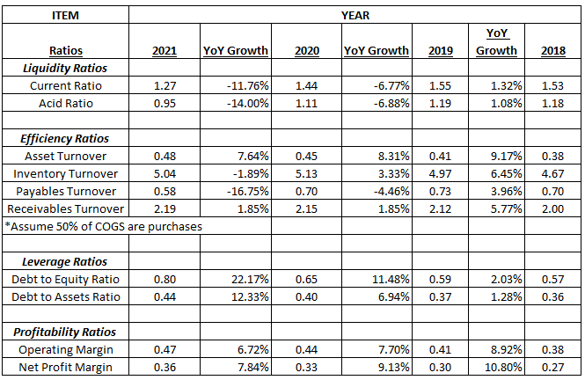
Trend Analysis of Ratios

Slide 120
Financial Analysis to determine investment suitability
Revenues
Quantity, quality and timing of revenues
Revenue Growth (ignore one-time revenues)
Revenue Concentration
Revenue per employee

Slide 121
Financial Analysis to determine investment suitability
Profits
Gross Profit Margin
Operating Profit Margin
Net Profit Margin

Slide 122
Financial Analysis to determine investment suitability
Operational Efficiency
Accounts receivables Turnover
Inventory Turnover
Market Data
Price to Earnings (PE) ratio
Price to Book (PB) ratio
Price Earnings Growth (PEG) Ratio

Slide 123
Financial Analysis to determine investment suitability
Capital Efficiency and Solvency
Return on Equity
Debt to Equity
Liquidity
DuPoint Index
Net Profit Margin x Asset Turnover x Equity Multiplier
(Net Income / Revenue) x ( Sales / Total Assets) x ( Total Assets / Shareholders Equity)

Slide 124
Financial Ratios in Banking
Profitability Calculation Ratios
Net Interest Margin : (Interest Income – Interest Expense) / Total Assets
Efficiency Calculation Ratios
Efficiency Ratio : Non-Interest Expense / Revenue
Operating Leverage : Growth Rate of Revenue – Growth Rate of Non-Interest Expense

Slide 125
Financial Ratios in Banking
Financial Strength Calculation Ratios
Liquidity Coverage Ratio: High Quality Liquid Asset Amount / Total Net Cash Flow Amount
Leverage Ratio : Tier 1 Capital / Total Assets (Exposure)
CET1 Ratio : Common Equity Tier 1 Capital / Risk-Weighted Assets

Slide 126
Financial Ratios in Insurance
Persistency Ratio
Number of policyholders paying premium / Net Active policyholders
Solvency Ratio
Available Solvency margin / Required Solvency Margin
Combined Ratio
Total outflow on operating expenses, commissions, claims and losses / Net Earned Premium

Slide 127
Financial Ratios in Insurance
Incurred Claims Ratio
Total Claims paid / Total premiums collected
Commission expense ratio
Commission Payment / Premiums Collected
Claim Settlement Ratio
Number of claims paid out / Number of claims received

Slide 128

Benchmarking of Financial performance
Compare ratios of the company with leading competitors
Compare ratios with industry average

Slide 129
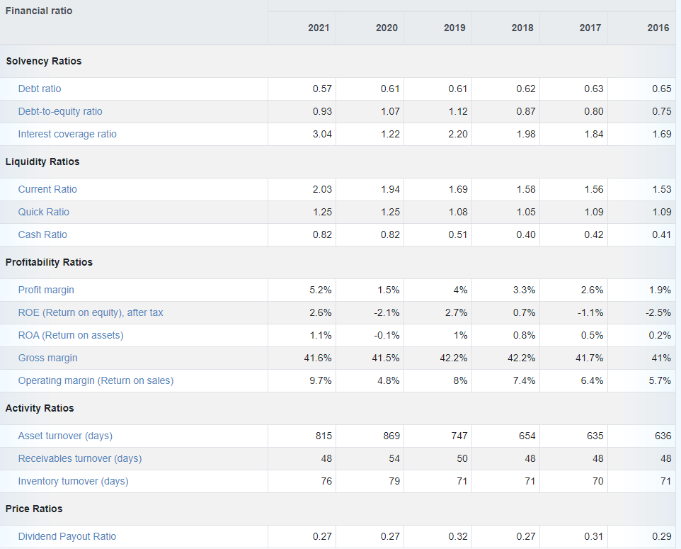
Benchmarking of Financial performance
Illustration of trend of US sectoral averages

Slide 130
Capital Budgeting
Planning for long term investments
Focus on cash flows rather than profits
Look at cash inflow and outflow and not accounting revenue and expenses
Includes adjustments for the time value of money

Slide 131
Time Value of Money
Money in hand is more valuable than same amount of money in the future
Opportunity cost is the interest that can be earned on the money or due to inflation
Components
  Present Value (PV)
  Future Value (FV)
  Number of Time Periods (N)
  Interest Rate (I)
  Payment Amount (PMT)

Slide 132
Present Value and Future Value
PV = FV / [ 1 + i] ^ n
FV = PV x [ 1 + i] ^ n
PV = Present Value
FV = Future Value
i= Interest Rate
n= Number of years

Slide 133
Present Value and Future Value - Example
Interest rate = 5%
Future Value of $10,000 today after 2 years
$10,000 x (1 + 5%) ^2 = $11,025
Present Value of $10,000 to be received after 2 years
$10,000 / (1+5%)^2 = $9070.30

Slide 134
Capital Budgeting Process
Identify long term goals
Identify potential investment proposals
Estimate and analyse the relevant cash flows from the proposal
Analyse financial feasibility
Choose projects to implement
Implement the projects
Monitor the projects

Slide 135
Capital Budgeting Methods
Payback Period
Discounted Payback Period
Net Present Value
Profitability Index
Internal Rate of Return

Slide 136
Payback Period
Time to recover the original investment
Does not include cash flows beyond payback period
Most useful for comparing projects with almost equal lives

Slide 137
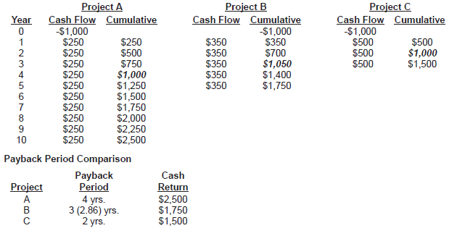
Payback Period Example

Slide 138
Discounted Payback Period
Accounts for the time value of money
Discount each future cash inflow to the present value
Discount rate is the cost of capital or potential rate of return

Slide 139
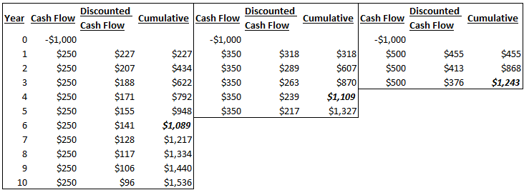
Discounted Payback Period Example

Slide 140
Net Present Value (NPV)
Present Value of all cash inflows – Present Value of all cash outflows
Accept all investments with a positive NPV and reject investments with a negative NPV

Slide 141
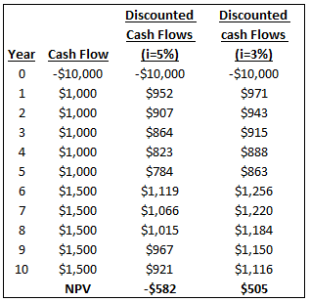
Net Present Value Example

Slide 142
Profitability Index (PI)
Divide the Present Value of cash inflows of the investment by the present value of cash outflows
Accept project with PI > 1

Slide 143
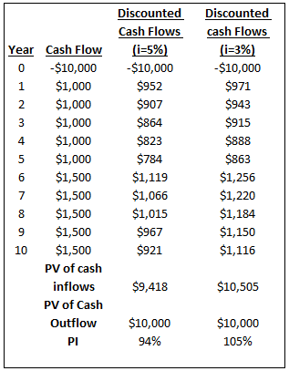
Profitability Index – Example

Slide 144
Internal Rate of Return (IRR)
Discount Rate that makes NPV equal to Zero
Accept project if IRR is greater than threshold rate
Reject project if IRR is lesser than threshold rate

Slide 145
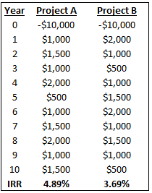
Internal Rate of Return Example

